Slide 1


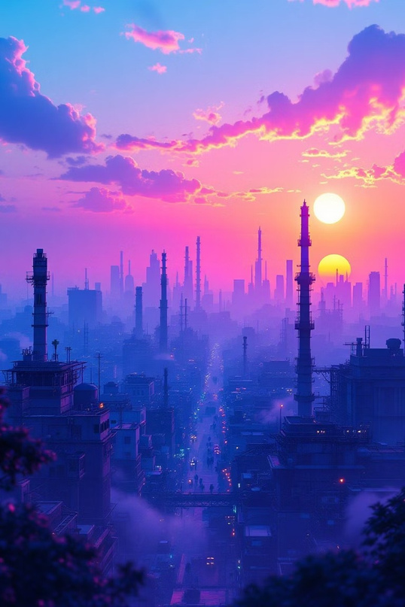
India's Air Under Pressure
Uncovering Pollution Trends (202232025)
Transforming Data into Stories that Inspire Action
Theme: Climate & Environment | Tool: Power BI Desktop
Problem Statement: To analyze India's air pollution patterns from 2022 to 2025,
identify major pollutants and most affected regions, and develop data-driven
recommendations for sustainable environmental action.

Slide 2


Dataset & Analytical Methodology
Data Foundation
Analysis Workflow
PrimarySource:CentralPollution Control Board (CPCB) & Data.gov.in Open
1
Data Collection
Data Portal
Time Period: January 2022 3 March 2025 Total Records: 10,000+ monitoring observations Key Variables:
CPCB monitoring stations nationwide
2
Data Cleaning
Geographic identifiers (city, state)
Pollutant classification & concentrations
Normalized pollution averages (pollutant_avg_norm)
Temporal tracking (last_update timestamps)
Standardization & validation in Excel
3
Dashboard Development
Interactive Power BI visualizations
4
Insight Generation
Pattern analysis & trend identification
5
Action Planning
Evidence-based recommendations
Data Source: Central Pollution Control Board (CPCB) Open Data Portal, Data.gov.in

Slide 3

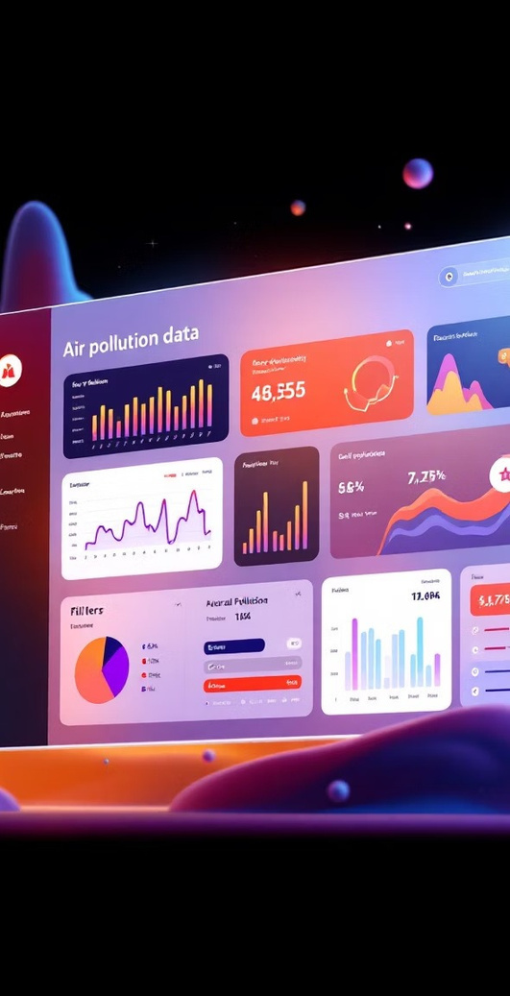
Interactive Dashboard Overview
Ourcomprehensive Power BIdashboard transforms complexenvironmentaldata into
actionable insights through intuitive visual storytelling. Theinteractiveplatform empowers stakeholders to explore pollution patterns dynamically across multiple dimensions.
Dynamic Filters
State-level selection, year range (202232025), and pollutant type categorization for customized analysis
Temporal Trends
Multi-year line charts revealing pollution evolution and seasonal patterns across India
Geographic Hotspots
Top 10 most polluted monitoring stations with city-wise and state-wise comparative averages
Pollutant Analysis
Breakdown of PM2.5, NO¢, O£, SO¢, and other air quality indicators with normalized scoring
Interactive dashboard visualizing real-time pollution severity across India (202232025),
enabling evidence-based environmental decision-making.

Slide 4
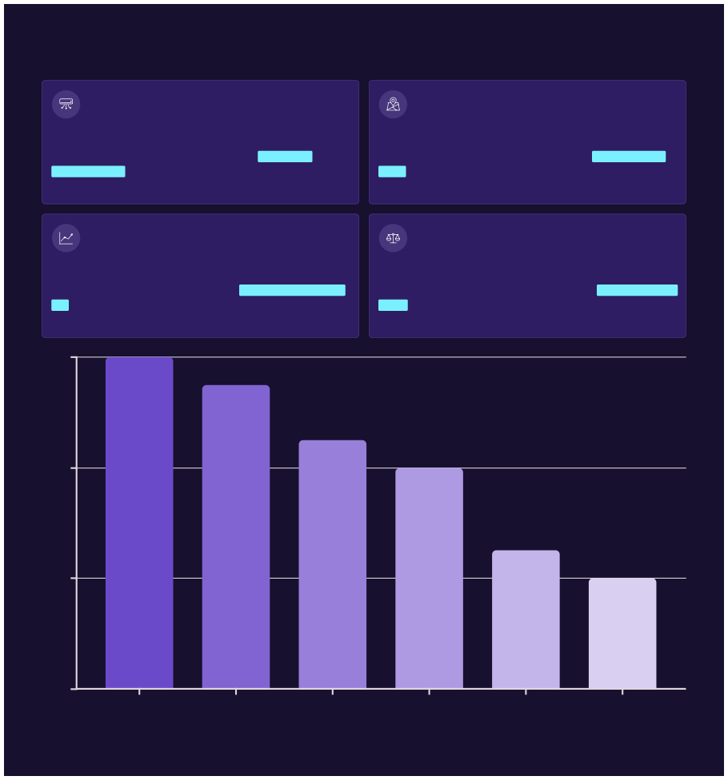

Key Insights: The Story Behind the Data
PM2.5 & NO¢ Dominance
Regional Hotspots
These twopollutants account forapproximately 15% of total pollution burden, representing the most significant air quality threat across Indian urban centers.
Delhi, Uttar Pradesh,and Maharashtra emerge as critical pollution
zones with normalized averages ranging from 0.09K to 0.12K.
Emerging Pollutants
North-South Divide
Ozone(O£)and sulfurdioxide (SO¢) show a gradual but concerning rise post-2023, indicating shifting pollution patterns.
NorthernIndiaexperiences Air Quality Index levels approximately 2×
higher than southern regions, reflecting geographic and industrial disparities.
0.12
0.08
0.04
0
Delhi NCR
Uttar Pradesh
Maharashtra
West Bengal
Kar nat aka
Kerala
The data reveals stark geographic inequalities in air quality, with northern industrial corridors bearing the heaviest environmental burden. This disparity demands region-specific intervention strategies tailored to local pollution sources and meteorological conditions.

Slide 5


Forecast & Future Trends
Predictive Modeling Results
Leveraging Power BI'sadvancedanalyticscapabilities, we applied time-
series forecasting to project pollution trajectories through 2026. The predictive model utilizes exponential smoothing algorithms to account
for seasonal variations and historical trends.
"PM2.5 concentrations are projected to rise by 12% in 2026 if
current emission patterns continue without significant mitigation
interventions."
Our forecast analysis reveals concerning upward trajectories for multiple
pollutants, particularly in metropolitan areas experiencing rapid
industrial expansion and vehicle fleet growth.
12%
PM2.5 Growth
8%
NO¢ Rise
15%
O£ Spike
2026
Critical Year
Projected increase by 2026
Expected annual growth rate
Ozone level elevation forecast
Intervention deadline window
Methodology Note: Predictive modeling enhances insight depth by transforming historical patterns into forward-looking intelligence. Our Power BI
forecast employs confidence intervals to account for uncertainty, providing decision-makers with realistic scenario planning tools for environmental
policy development.

Slide 6


Turning Insights into Action
Data withoutaction remainsmerelyinformation.Our analysistranslatescomplex environmental patterns into concrete, implementable strategies that
addressIndia'smost pressingairqualitychallenges. Eachrecommendationtargets specific pollutant sources identified through our comprehensive data analysis.
1
2
High PM2.5 in Delhi NCR
Rising NO¢ in Maharashtra
Problem: Particulate matter from vehicle emissions, construction dust, and seasonal crop burning creates hazardous air quality conditions.
Recommendation: Accelerate electric vehicle adoption through
subsidies, expand metro networks, create mandatory green buffer
zones around highways, and implement strict construction dust
control protocols.
Problem: Industrial corridors and dense vehicular traffic drive nitrogen dioxide concentrations to dangerous levels in Mumbai and Pune.
Recommendation: Enforce stricter industrial emissions standards
with real-time monitoring, mandate cleaner fuel alternatives, and
establish industrial park emission caps with financial penalties.
3
4
O£ Spikes Post-2023
Poor AQI Awareness
Problem: Ground-level ozone formation accelerates due to increasing temperatures and precursor pollutant interactions.
Recommendation: Expand urban forestry programs with native tree
species, create rooftop garden incentives, launch public awareness
campaigns on ozone health risks, and reduce VOC emissions from
industries.
Problem: Citizens lack real-time air quality information to make informed health decisions and protective behavioral changes.
Recommendation: Deploy mobile AQI alert systems with SMS/app
notifications, install public AQI display boards at major intersections,
integrate AQI data into weather forecasts, and establish school-
based air quality education programs.
Implementation Priority: These recommendations should be executed in phased approaches, beginning with high-impact, low-cost interventions like public awareness systems, followed by medium-term infrastructure investments in green spaces and electric mobility, culminating in long-term industrial policy reforms.

Slide 7
Impact Pathways: From Data to Change
Transportation Revolution
Industrial Transformation
Green Infrastructure
Digital Empowerment
Transitioning to electric public transport and incentivizing private EV adoption can reduce PM2.5 and NO¢ by up to 30% in metropolitan
areas within five years.
Real-time emissionmonitoring systems coupled with financial incentives for cleaner technology adoption create sustainable
industrial practices that protect air
quality.
Strategic urbanforestryand green corridor development not only absorb pollutants but also reduce urban heat island effects that
exacerbate ozone formation.
Technology-enabled AQI
awareness systems empower citizens to protect their health through behavioral adaptations
during high-pollution episodes.
Multi-Stakeholder Engagement
Measurable Outcomes
Effective air quality improvement requires coordinated action across government agencies, private sector partners, and civil society organizations. Our recommendations provide clear accountability frameworks for each stakeholder group.
Each intervention strategy includes specific, quantifiable success metrics enabling continuous monitoring and adaptive management to maximize environmental impact.

Slide 8






Conclusion & Future Research Directions
Key Takeaways
India's air pollutioncrisis is dominated by PM2.5 and NO¢, with northern states
facing disproportionate environmental burden. Our analysis reveals that without immediate intervention, pollution levels are forecast to increase by 12315% by
2026, threatening public health and economic productivity.
However, data-driven insights illuminate a pathway toward sustainable change.
Strategic investments in clean transportation, industrial regulation, urban
greening, and public awareness can reverse these alarming trends.
Future Research Opportunities
1
2
Seasonal Pattern Analysis
Climate Correlation Studies
Develop predictive models incorporating monsoon impacts, crop burning seasons, and winter inversion effects on AQI fluctuations
Analyze relationships between temperature, rainfall, humidity, and pollutant concentrations to enhance forecasting accuracy
3
4
Health Impact Assessment
Policy Effectiveness Evaluation
Integrate respiratory disease data with pollution metrics to quantify public health costs and intervention benefits
Implement before-after studies measuring real-world impact of implemented environmental regulations
"The air we breathe defines the future we build. Through rigorous data analysis and evidence-based action, we can transform India's environmental trajectory from crisis to opportunity."

Slide 9

Transforming Data into Stories
that Inspire Action
Explore the Dashboard
Project Recognition
Competition: DataVision 2025 Theme:Climate &Environment Institution:IIT Patna Tools: Power BI, Excel, Python Data Sources: CPCB, Data.gov.in
Access ourinteractivePowerBIdashboardtodivedeeperintoIndia'sair
pollution patterns, customizeviewsbyregionandtimeframe,and discover additional insights.
Dashboard Features:
Real-time pollution tracking
Custom geographic filters
Temporal trend analysis
Comparative visualizations
Downloadable reports
This presentation demonstrates how advanced data visualization transforms complex environmental challenges into actionable intelligence, empowering stakeholders to make informed decisions for a sustainable future.
Contact & Collaboration: For questions about our methodology, access to underlying datasets, or potential research collaborations, please reach out through the competition portal. Together, we can breathe life into data-driven environmental solutions.

